Slide 1
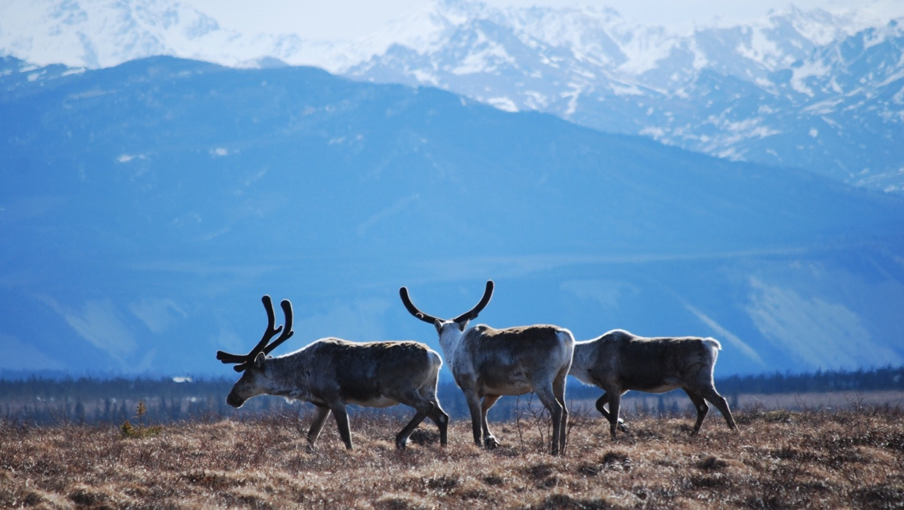
Arctic Boreal Vulnerability Experiment (ABoVE)
2019 ABoVE Airborne Flights
23 July 2022 (DOY 203)
Fairbanks Area
Charles Miller, Deputy Science Lead
Jet Propulsion Laboratory, California Institute of Technology
and the ABoVE Science Team For Hank Margolis, Mike Falkowski, Bruce Tagg, Jack Kaye
NASA HQ
2022

Slide 2
23 July 2022 (DOY 203) Fairbanks Area
Daily Status:
AVIRIS-NG / Dynamic Aviation B-200 (N53W)
REPORT DATE: 23 July 2022
Current Status of Aircraft: GREEN
Current Status of AVIRIS: GREEN
Current Deployment Location: Fairbanks AK(PAFA)
Crew: S Wilson (PIC), P Nichols, L Rios, J Chapman
Science Planning: A Thorpe
Data Processing: W Olsen-Duvall, J Chapman
Instrument Manager: M Eastwood
Instrument PI: R Green
Science Lead: C Miller

Slide 3
23 July 2022 (DOY 203) Fairbanks Area
Daily Summary:
Forecast suggested Fairbanks area would be partly cloudy with areas of clear skies for first time in 10 days, but clouds moved in faster than expected
Partly to mostly cloudy conditions encountered throughout the domain
Flight terminated early

Slide 4
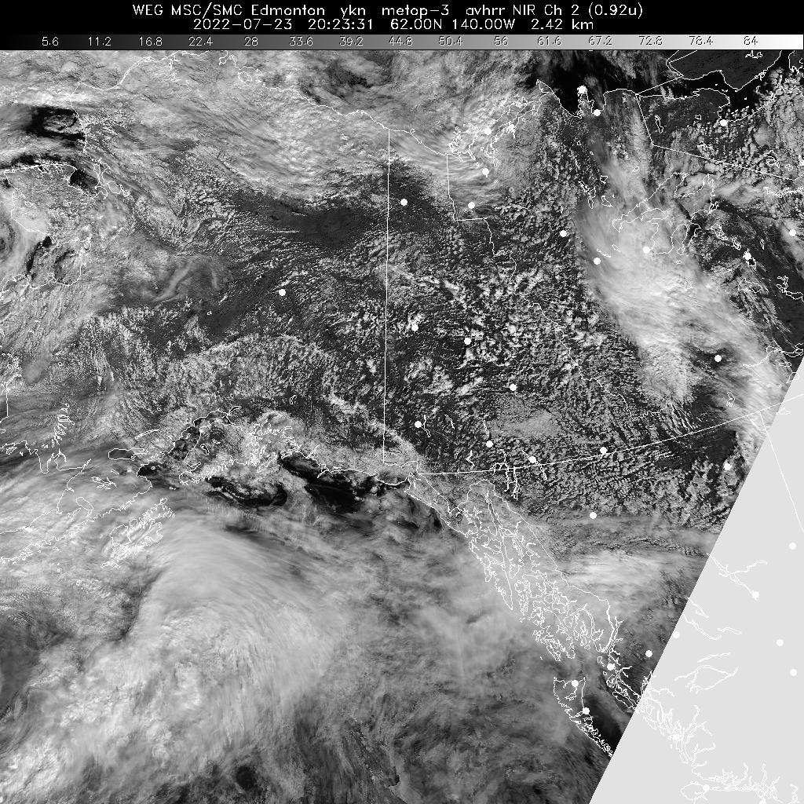
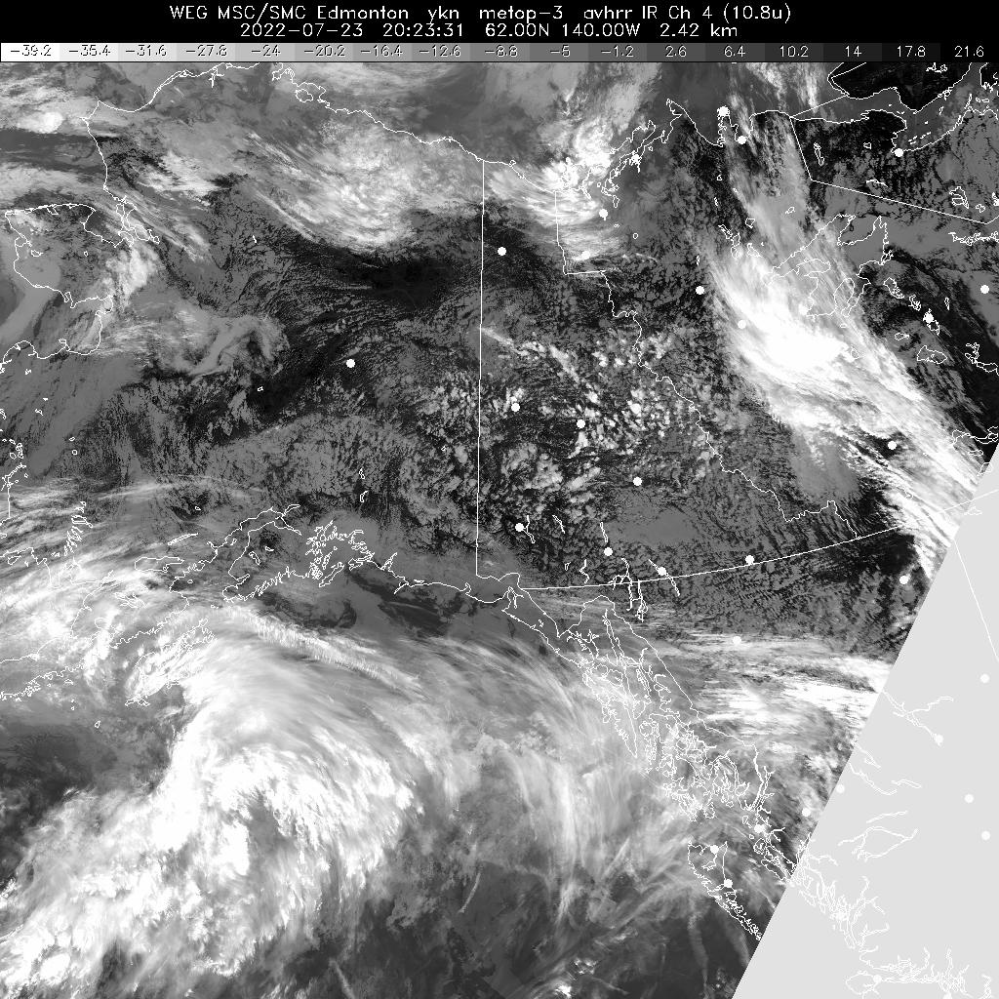
23 July 2022 (DOY 203) Fairbanks Area
Notes:
Partly clear over Fairbanks area, searching for openings

Slide 5
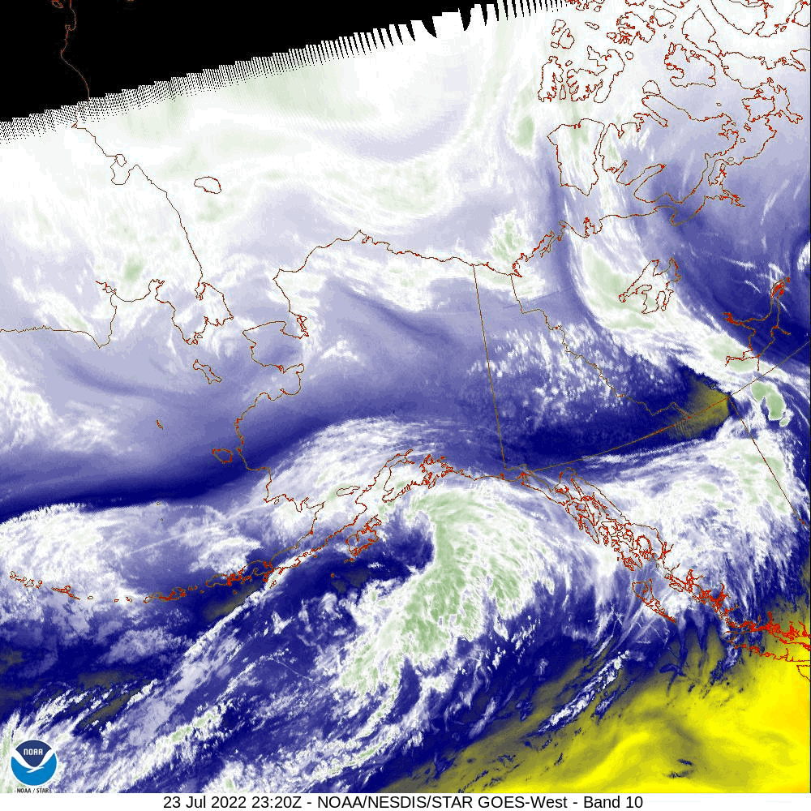
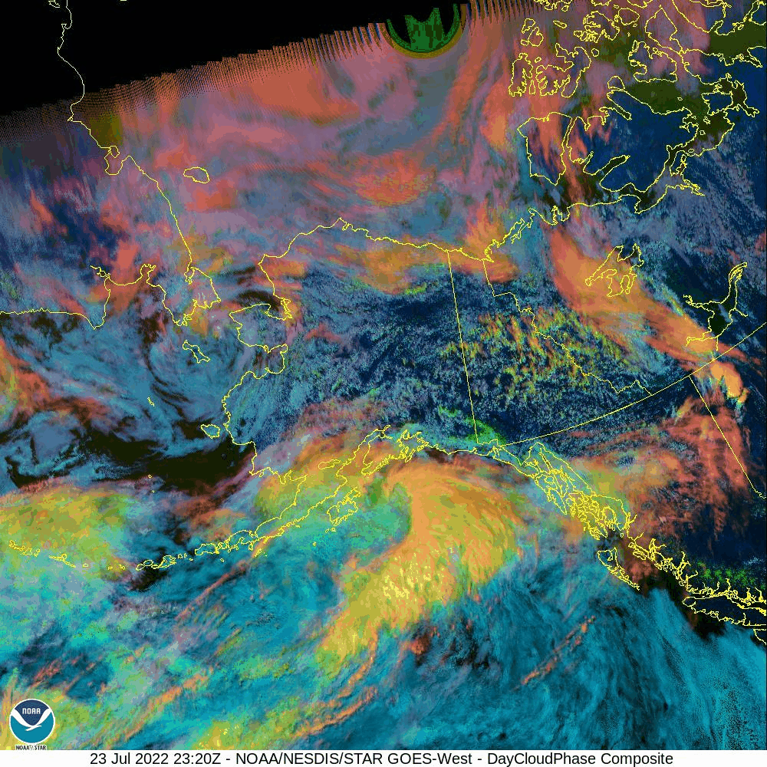
23 July 2022 (DOY 203) Fairbanks Area

Slide 6
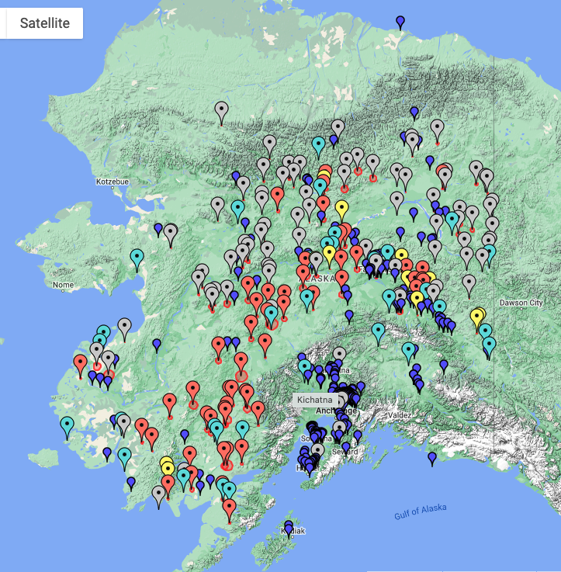
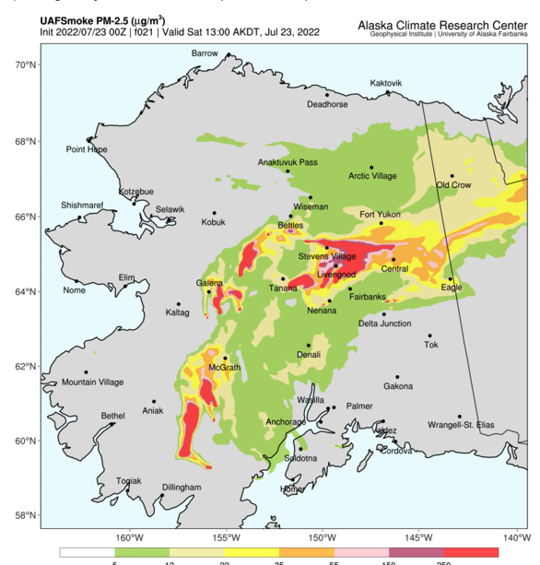
23 July 2022 (DOY 203) Fairbanks Area
Notes:
Wildfire smoke has largely dissipated from Fairbanks area
AQI = 2 @ 1500 AKDT

Slide 7
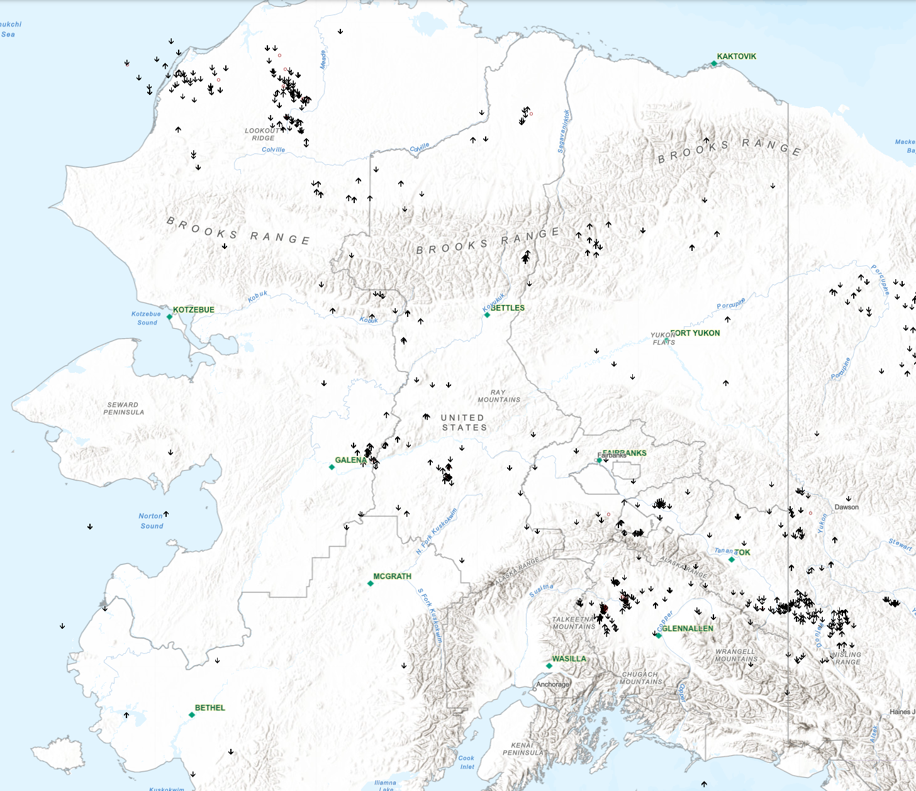
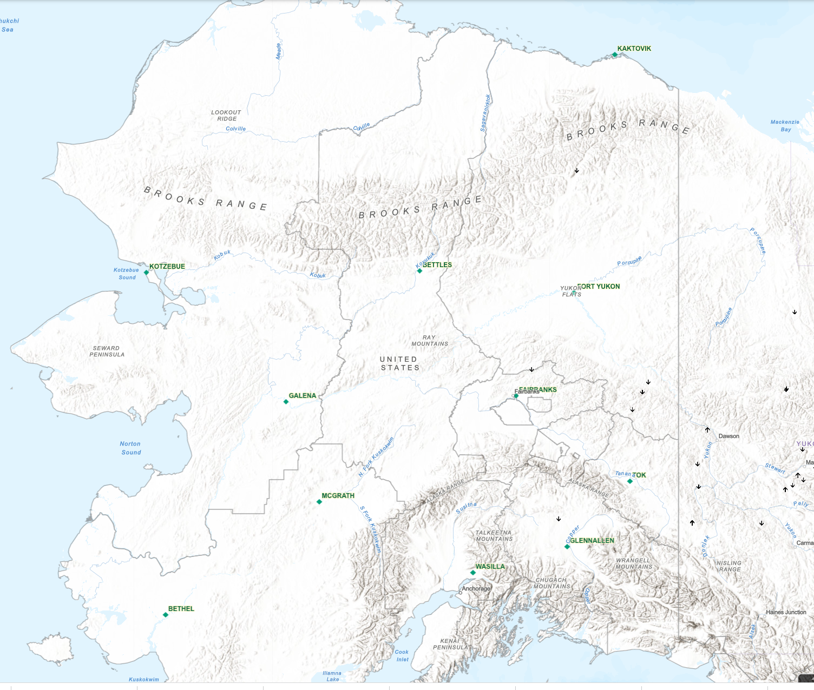
23 July 2022 (DOY 203) Fairbanks Area
Alaska Lightning strikes: 20-22 July 2022
Alaska Lightning strikes: 23 July 2022 from 0600 AKDT
Notes:
https://www.arcgis.com/apps/webappviewer/index.html?id=f5c311fa930d4831916c3f27984e97fd&extent=-21498469.1666%2C7047820.6016%2C-12281998.0441%2C11636488.2836%2C102100
Only a handful of lightning strikes despite the dense cloud cover

Slide 8
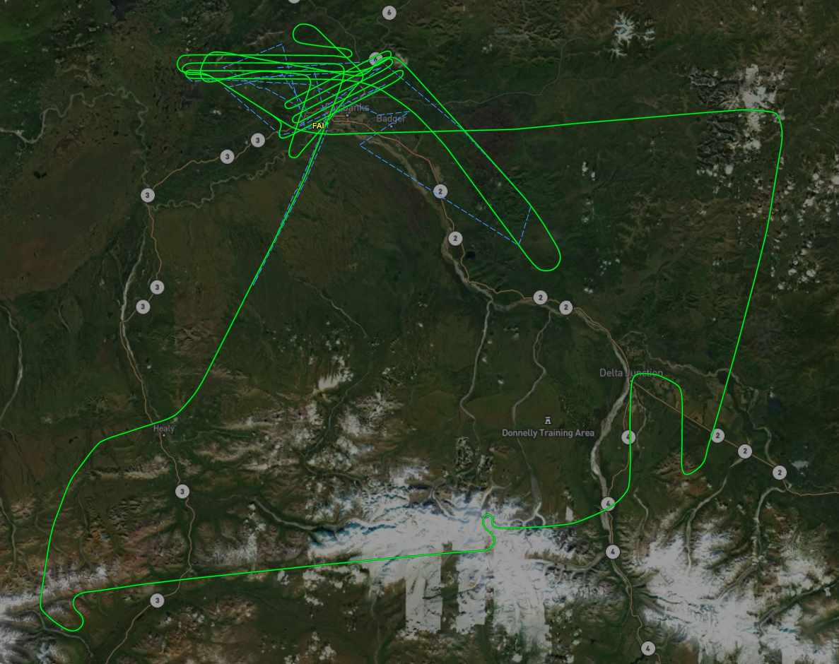
23 July 2022 (DOY 203) Fairbanks Area
Flight Plan: All Lines
As Flown Lines
Notes:
Sortie #1 As Flown Lines plot is incomplete – tracker lost for Kougarok and Teller area lines

Slide 9
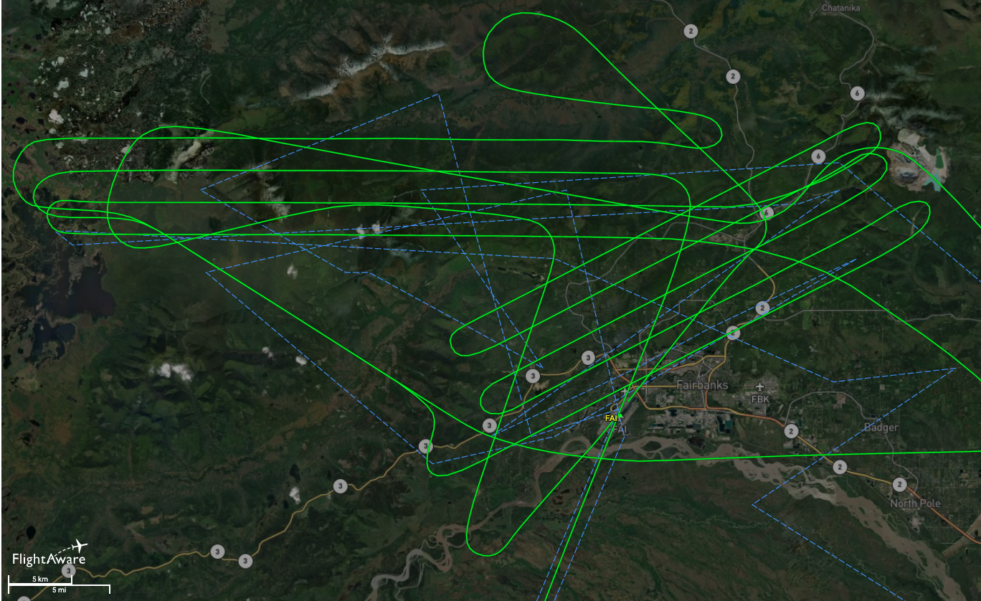
23 July 2022 (DOY 203) Fairbanks Area
Flight Plan: All Lines
As Flown Lines
As Flown Lines: Fairbanks Area Detail
Notes:
Sortie #1 As Flown Lines plot is incomplete – tracker lost for Kougarok and Teller area lines

Slide 10
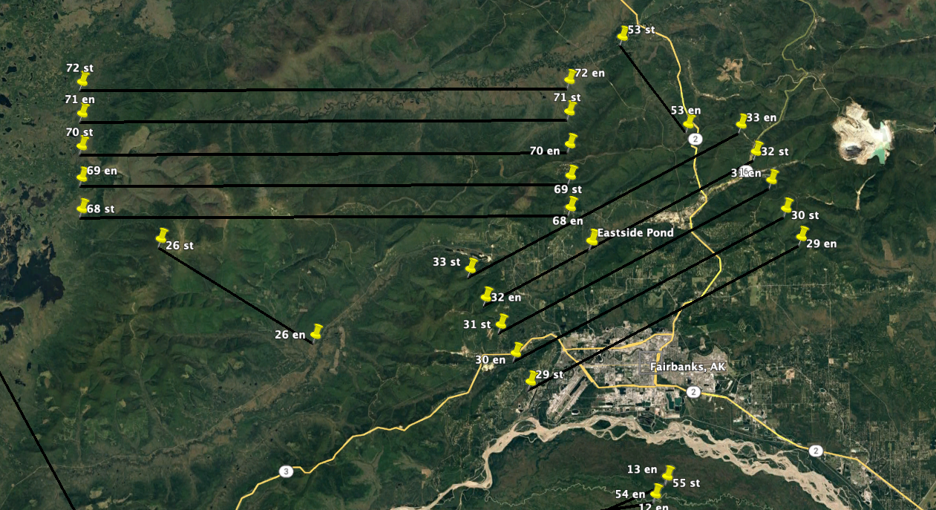
23 July 2022 (DOY 203) Fairbanks Area
As Flown Lines: Sortie #1
Flight Plan Detail
Notes:
Huslia grid acquired under “very clear” sky conditions

Slide 11
23 July 2022 (DOY 203) Fairbanks Area
AVIRIS-NG Quick-look products
https://avirisng.jpl.nasa.gov/cgi/flights.cgi?step=view_flightlog&flight_id=ang20220723t
A. Track Air: B1-68. LineID: B02_L001_FL180 , File: ang20220723t184235_raw : Shovel Creek fire scar grid
B. Track Air: B1-69. LineID: B02_L002_FL180 , File: ang20220723t185054_raw : Shovel Creek fire scar grid
A
B
Large clouds @ center of line
Same
Notes:
Huslia grid

Slide 12
23 July 2022 (DOY 203) Fairbanks Area
AVIRIS-NG Quick-look products
https://avirisng.jpl.nasa.gov/cgi/flights.cgi?step=view_flightlog&flight_id=ang20220723t
A. Track Air: B2-33. LineID: B10_L005_FL175 , File: ang20220723t190114_raw : Goldstream Valley grid
B. Track Air: B2-32. LineID: B10_L004_FL175 , File: ang20220723t190728_raw : Goldstream Valley grid
A
B
Clouds at end
Same
Notes:
Huslia grid

Slide 13
23 July 2022 (DOY 203) Fairbanks Area
AVIRIS-NG Quick-look products
https://avirisng.jpl.nasa.gov/cgi/flights.cgi?step=view_flightlog&flight_id=ang20220723t
A. Track Air: B2-31. LineID: B10_L003_FL175 , File: ang20220723t191332_raw : Goldstream Valley grid
B. Track Air: B2-30. LineID: B10_L002_FL175 , File: ang20220723t191937_raw : Goldstream Valley grid
A
B
Clouds at end
Same
Notes:
Huslia grid

Slide 14
23 July 2022 (DOY 203) Fairbanks Area
AVIRIS-NG Quick-look products
https://avirisng.jpl.nasa.gov/cgi/flights.cgi?step=view_flightlog&flight_id=ang20220723t
A. Track Air: B2-29. LineID: B10_L001_FL175 , File: ang20220723t192604_raw : Goldstream Valley grid
B. Track Air: B1-26. LineID: MAC_L012_FL175 , File: ang20220723t193409_raw : Murphy Dome long-term sites
A
B
Popcorn clouds at beginning, otherwise mostly clear
Clouds throughout
Notes:
Huslia grid

Slide 15
23 July 2022 (DOY 203) Fairbanks Area
AVIRIS-NG Quick-look products
https://avirisng.jpl.nasa.gov/cgi/flights.cgi?step=view_flightlog&flight_id=ang20220723t
A. Track Air: B1-70. LineID: B02_L003_FL180 , File: ang20220723t194021_raw : Shovel Creek fire scar grid
B. Track Air: G-1. LineID: HUN_G001_FL180 , File: ang20220723t200852_raw : Healy/8-Mile Lake flux tower
A
B
Clouds at end
Clouds throughout
Notes:
Huslia grid

Slide 16
23 July 2022 (DOY 203) Fairbanks Area
AVIRIS-NG Quick-look products
https://avirisng.jpl.nasa.gov/cgi/flights.cgi?step=view_flightlog&flight_id=ang20220723t
A. Track Air: G-2. LineID: MAG_G001_FL180 , File: ang20220723t205534_raw : Delta Junction NEON Box + Flux tower
B. Track Air: G-3. LineID: MAC_G001_FL180 , File: ang20220723t210424_raw : Mack DJ sites
A
B
Clouds throughout
Clouds throughout
Notes:
Huslia grid

Slide 17
23 July 2022 (DOY 203) Fairbanks Area
AVIRIS-NG Quick-look products
https://avirisng.jpl.nasa.gov/cgi/flights.cgi?step=view_flightlog&flight_id=ang20220723t
A. Track Air: B1-26. LineID: MAC_L001_FL175 , File: ang20220723t215027_raw : Murphy Dome long-term sites
B. Track Air: B1-71. LineID: B02_L004_FL180 , File: ang20220723t215722_raw : Shovel Creek fire scar
A
B
Clouds throughout
Clouds at end
Notes:
Huslia grid

Slide 18
23 July 2022 (DOY 203) Fairbanks Area
BACKUP

Slide 19
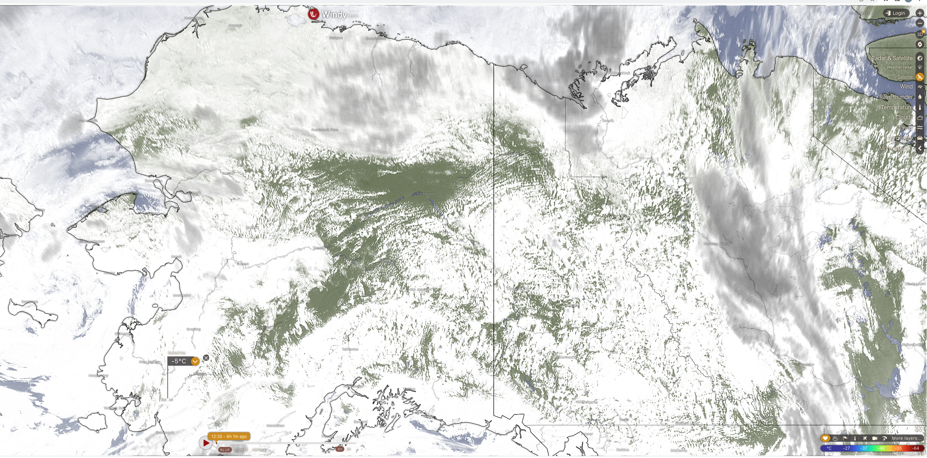
23 July 2022 (DOY 203) Fairbanks Area
As Flown Lines: Sortie #1

Slide 20
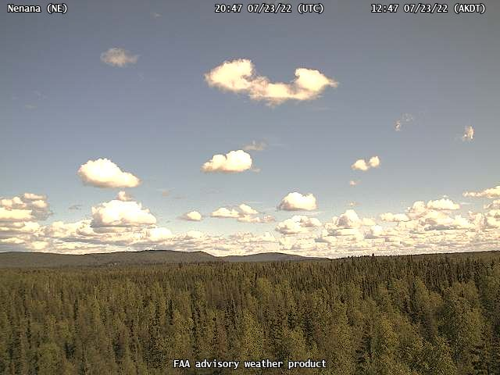
23 July 2022 (DOY 203) Fairbanks Area
As Flown Lines: Sortie #1

Slide 21
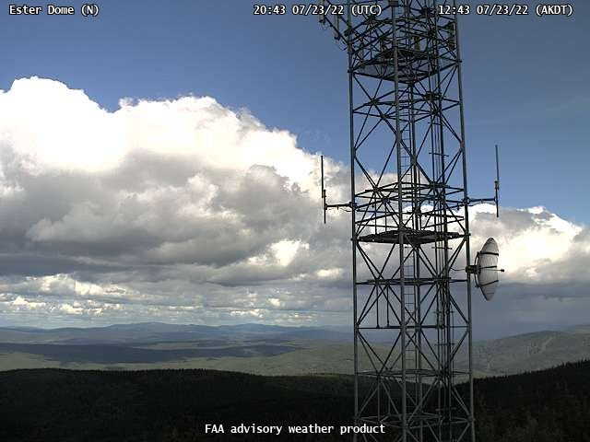
23 July 2022 (DOY 203) Fairbanks Area
As Flown Lines: Sortie #1

Slide 22
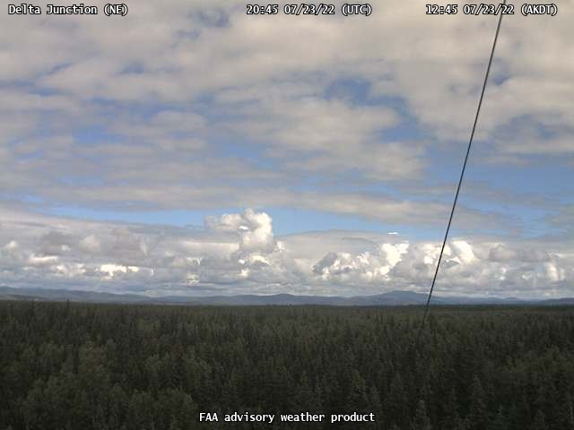
23 July 2022 (DOY 203) Fairbanks Area
As Flown Lines: Sortie #1

Slide 23
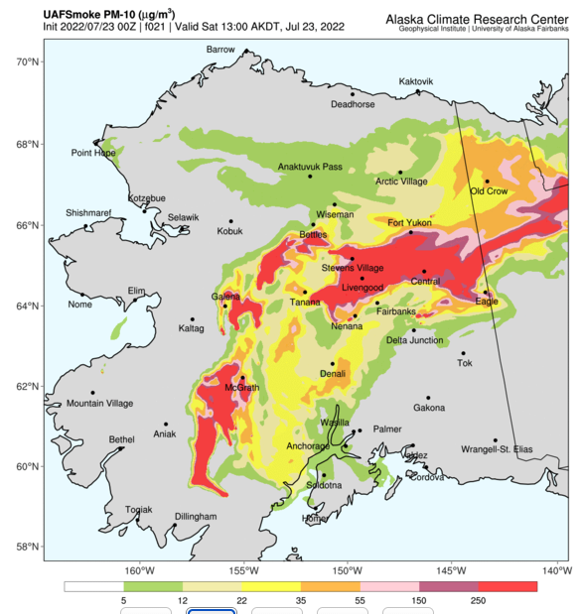
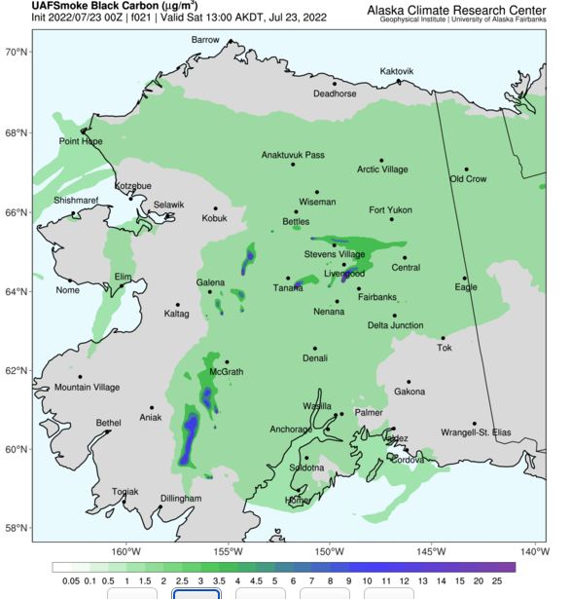
23 July 2022 (DOY 203) Fairbanks Area
PM10
BC

